Slide 1
架构图

Slide 2



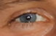


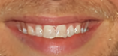


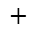
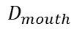
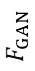
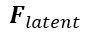
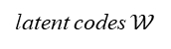
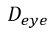
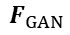
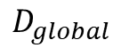
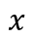
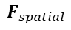
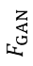
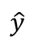
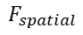
Degradation Removal
Pretrained GAN as prior
$$F_{latent}$$
latent codes $𝒲$
Losses
MLP
$$D_{global}$$
Adversarial Loss
CS-SFT
CS-SFT
CS-SFT
$$F_{GAN}$$
$$F_{GAN}$$
$$F_{GAN}$$
$$x$$
$$\hat{y}$$
$$D_{eye}$$
$$F_{spatial}$$
ROI
align
$$D_{eye}$$
Facial Component
Loss
Channel-Split SFT
identity
$$D_{mouth}$$
$$F_{GAN}$$
Spatial Feature
Transform (SFT)
$$×$$
$$+$$
Face Recognition
Feature Extractor
Identity
Preserving Loss
Restoration Loss
conv
$$F_{spatial}$$
Notes:
https://github.com/TencentARC/GFPGAN

Slide 3

first order
Blur
Resize
(Downsampling)
Noise
JPEG
Compression
(Generalize) Gaussian filter
- isotropic
- anisotropic
2D sinc filter
Gaussian noise
Poisson noise
Color noise
Gray noise
Resize
- bicubic
- bilinear
- area
JPEG
second order
Blur
Resize
(Downsampling)
Noise
JPEG
+ 2D sinc filter
Notes:
Real-ESRGAN

Slide 4

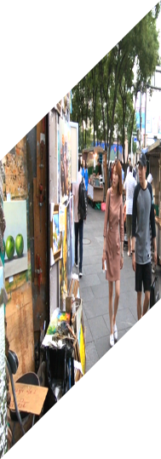



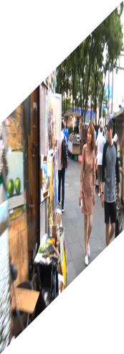
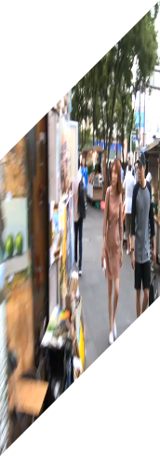
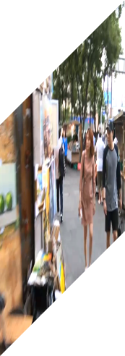
Video Super-Resolution
$$t−1$$
$$t$$
$$t+1$$
↑
Upsampling
PreDeblur
Module
PCD Align
Module
TSA Fusion
Module
Reconstruction
Module
+
$$t−1$$
$$t$$
$$t+1$$
Aligned Features
Upsampling
Downsampling
$$t−1$$
$$t$$
$$t+1$$
Video Deblurring
Notes:
EDVR: Video Restoration with Enhanced Deformable Convolutional Networks

Slide 5
Residual block
Conv
SFT layer
Conv
SFT layer
Conv
Residual block
Residual block
SFT layer
Conv
Conv
Conv
Conv
total 16 residual blocks
Upsampling
SFT layer
Perceptual
loss
GAN loss
Shared SFT conditions
Conv
Conv
Conv
Conv
$$⨀$$
$$+$$
VGG network
Discriminator
features
$$γ_{i}$$
$$β_{i}$$
Segmentation
probability maps
Condition Network
Conv
Conv
Conv
Conv
conditions
Notes:
Recovering Realistic Texture in Image Super-resolution by Deep Spatial Feature Transform

Slide 6
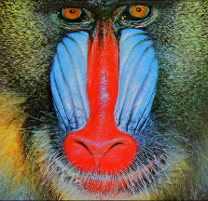

Conv
Conv
Conv
Conv
Basic Block
Basic Block
Basic Block
Upsampling
LR
SR
Residual Block (RB)
Residual in Residual Dense Block (RRDB)
Conv
BN
ReLU
Conv
BN
Conv
ReLU
Conv
Dense
Block
Dense
Block
Dense
Block
$$×β$$
$$×β$$
$$×β$$
Conv
LReLU
Conv
LReLU
Conv
LReLU
Conv
LReLU
Conv
+
+
+
$$×β$$
+
+
+
SRGAN
RB w/o BN
Notes:
ESRGAN: Enhanced Super-Resolution Generative Adversarial Networks

Slide 7
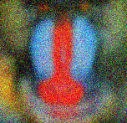
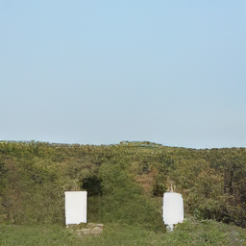
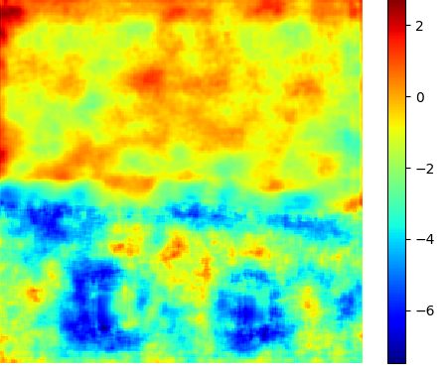
$$×4$$
ESRGAN Arch
$$×2$$
Pixel Unshuffle
Conv
Conv
Conv
Conv
RRDB
Block
RRDB
Block
Upsampling
(X4)
$$×1$$
Pixel Unshuffle
Output
Input
conv
spectral norm

Slide 8
模块图

Slide 9
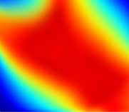

$$t=0$$
$$t=i$$
offset $∆_{i}^{l−1}$
$$l−1$$
upsampling
2
$${\hat{F}}_{i}$$
gate$1$
$$l$$
$$F_{0}^{l}$$
$$F_{i}^{l}$$
Warping
$${\hat{F}}_{i}^{l}$$
$${\tilde{F}}_{i}$$
$$f^{l}(∙)$$
$$l+1$$
gate$2$
offset $∆_{i}^{l}$
$$F_{0}$$
Notes:
Understanding Deformable Alignment in Video Super-Resolution

Slide 10




$$F_{t}$$
Reference
Features
Concat
Offsets
$$F_{t+i}$$
$${\hat{F}}_{t+i}$$
warping
convolution
Deformable Conv
Warped features by different groups of offsets
Neighboring
Features
Aligned
Features
a) Deformable Convolution
b) Deformable Alignment
Notes:
Understanding Deformable Alignment in Video Super-Resolution

Slide 11
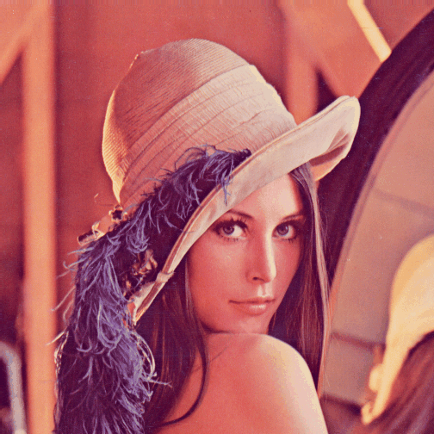

PSNR/dB
Two-branch
One-branch
Degradation
Prediction
Restoration
Conditional
Restoration
Two-branch Network
One-branch Network
blur
blur+noise
blur
blur+noise
DAN
DASR
Notes:
Finding Discriminative Filters for Specific Degradations in Blind Super-Resolution

